Slide 1
Alert
The warning app
by
Julia
Markus
Peter

Slide 2

Task
Build a model which is capable of correctly classify tweets as either disaster tweets or false alerts

Slide 3
Strategy
data exploration
clean keywords
transform text via NLP techniques
perform different ML approaches to find best differentiator model
build app using a ML pipeline to predict alert situations

Slide 4
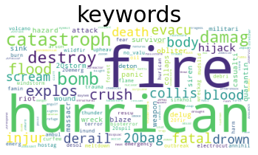
Workbench
Day 1:
Setup strategy, git project (group)
data wrangling ( group)
NLP basics (group)
first prediction (group)

Slide 5
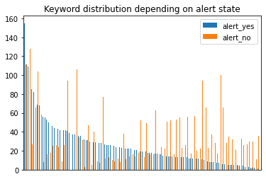
Workbench
Day 2:
find best pipe to predict real and false alerts (individual)
visualize keyword distribution depending on alert state (individual)
programming warning app for users (individual)

Slide 6
Workbench
Day 3:
Git (group)
different NLP and ML techniques ( group)
many different models tested
NLP:
Cleaning, lemmatising and vectorizing (TFVdif and CountVectorizer)
Tweets text, Keywords and Tweet text + Keywords
ML Models:
all Classifiers we heard about in this course

Slide 7
Models, Scores and huge Matrices
Logistic Regression /TFIDF Vectorizer 0.81
XGBOOST Classifier /TFIDF Vectorizer 0.73
Gridsearch + XGB /TFIDF Vectorizer 0.75
Decistion Tree /TFIDF Vectorizer 0.75
KNN /TFIDF Vectorizer 0.68
Naive Bayes /TFIDF Vectorizer 0.82
Voting (Logistic Regresiion and NAIVE BAYES) 0.81
Stacking (LogReg, KNN, Naive Bayes 0.82
Naive Bayes (HE Keywords + Text in Sparse Matrix) 0.81

Slide 8
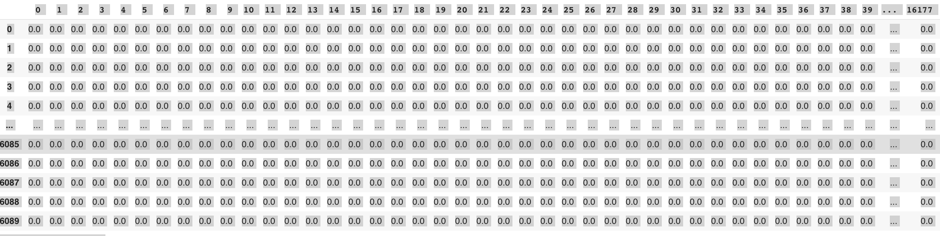
Models, Scores and huge Matrices

Slide 9

Predict/Classify new Tweets
Life Demo

Slide 10
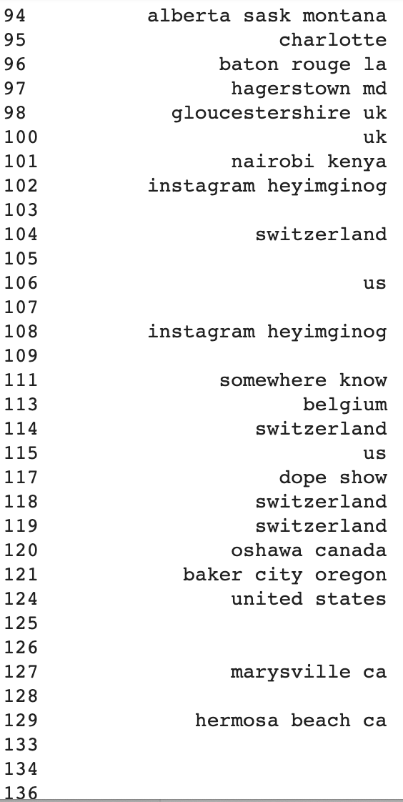
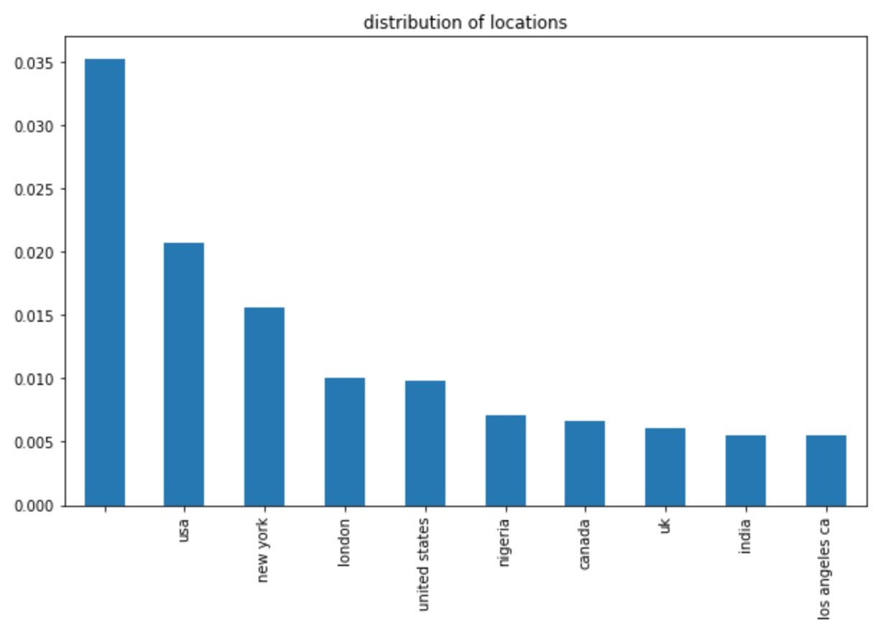
Workbench
Day 4: df['location_clean']
No Value

Slide 11
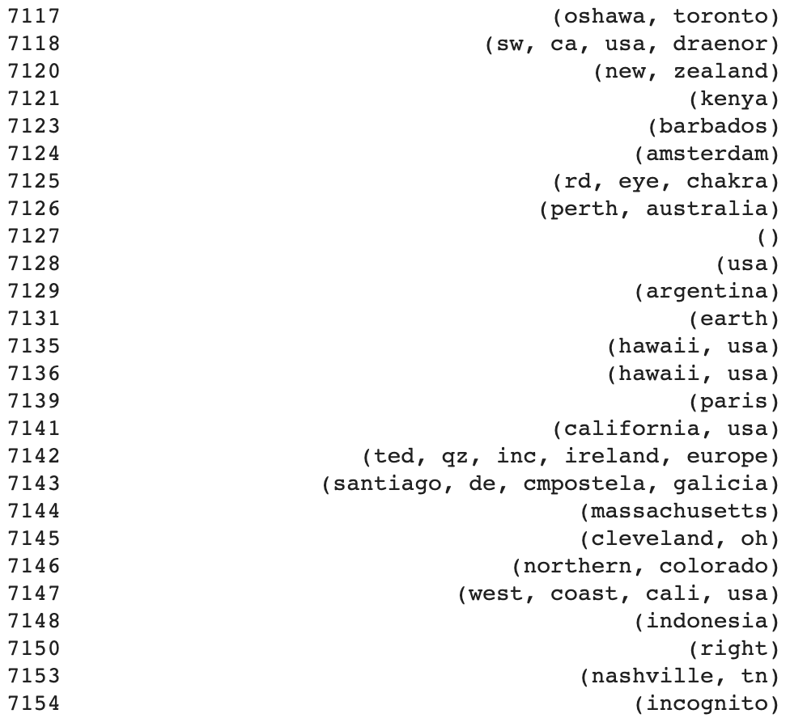
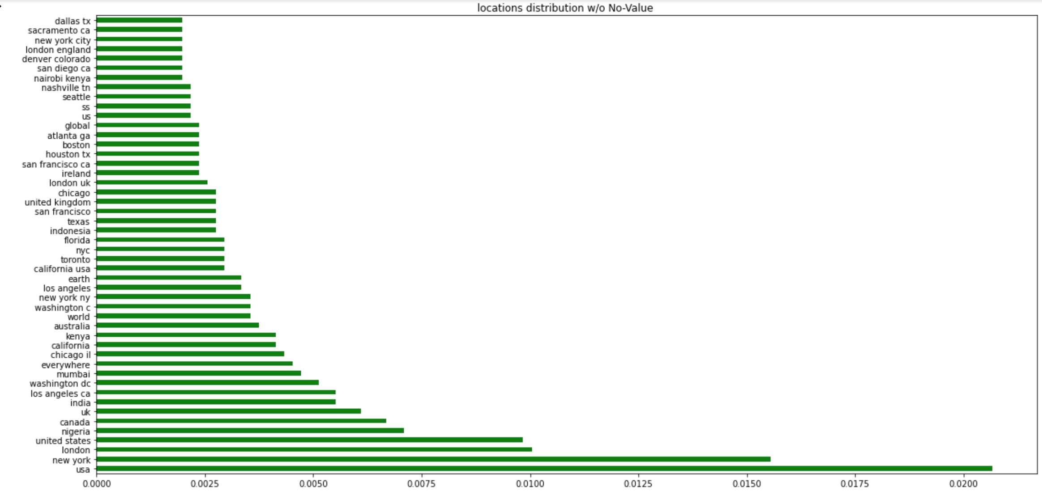
Workbench
doc_loc =df['location_clean'].apply( lambda satz: nlp(satz) )

Slide 12
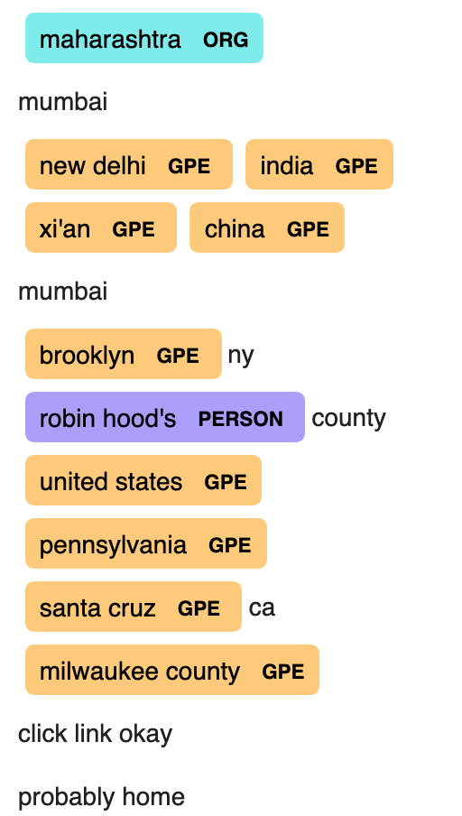

Finde den Fehler
displacy.render(doc_loc, style="ent", jupyter=True)

Slide 13
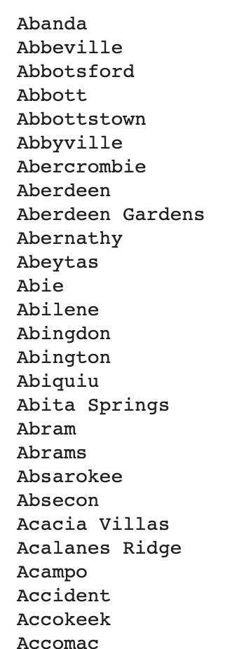
Finde in Stadtliste
https://www.mithrilandmages.com/utilities/CityBrowse.php
Explorative Datenanalyse
Original Data:
5080
Number of locations with True Alert (1)
1328
Number of locations with False Alert (0)
1898
All data with a locations
2895
if string is in cities_list: location_list.append()

Slide 14
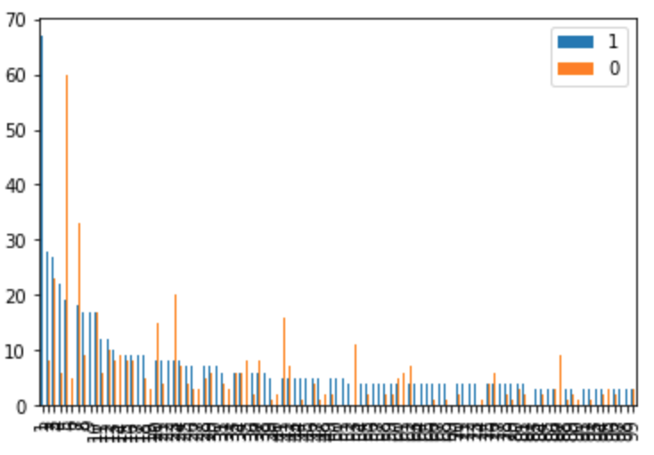
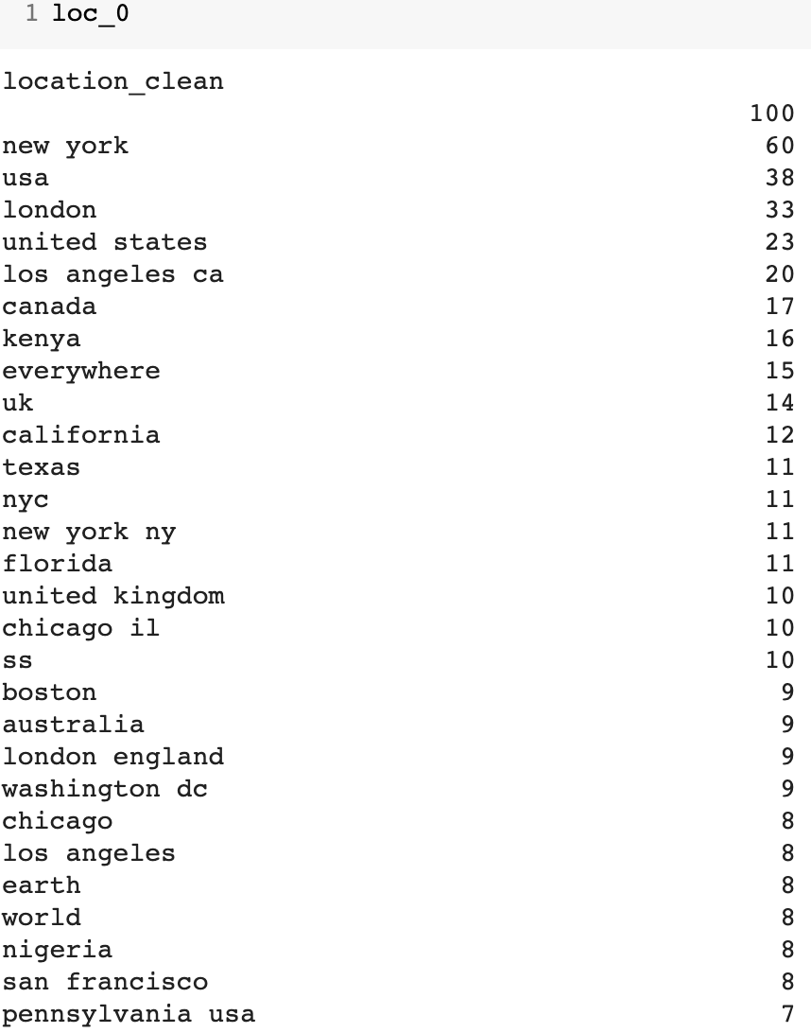
Führt zu sauberen Listen - only

Slide 15
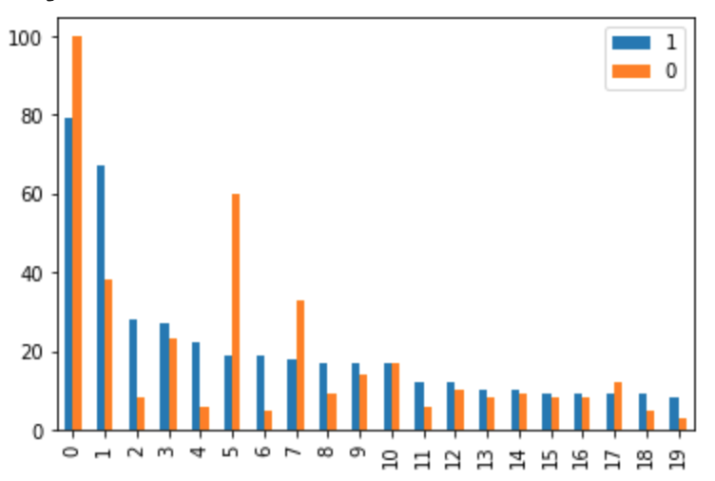
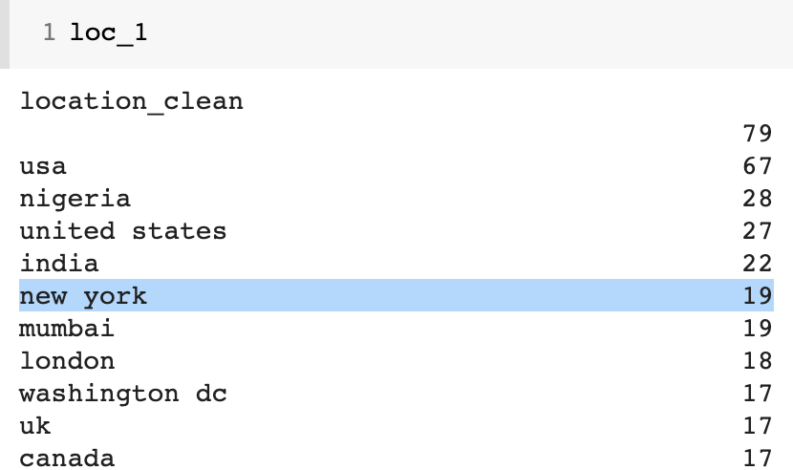
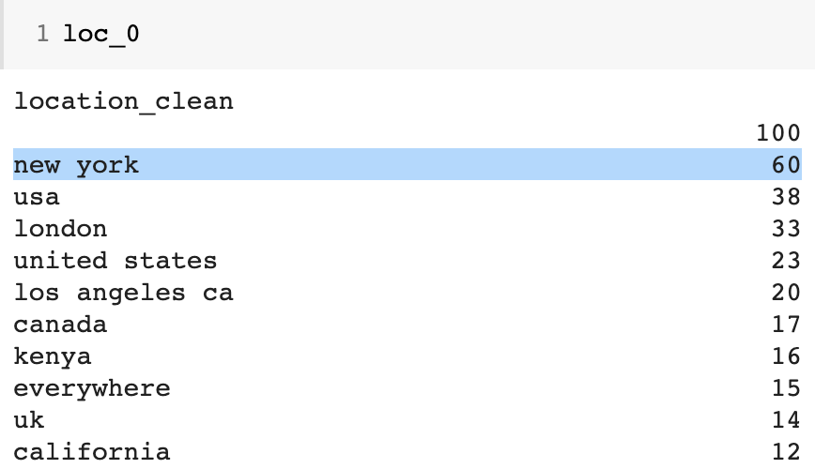
Eins - sortiert
0. No Value (79/100)
USA (67/38)
Nigeria (28/8)
United States (27/23)
India (22/6)
New York (19/60)

Slide 16
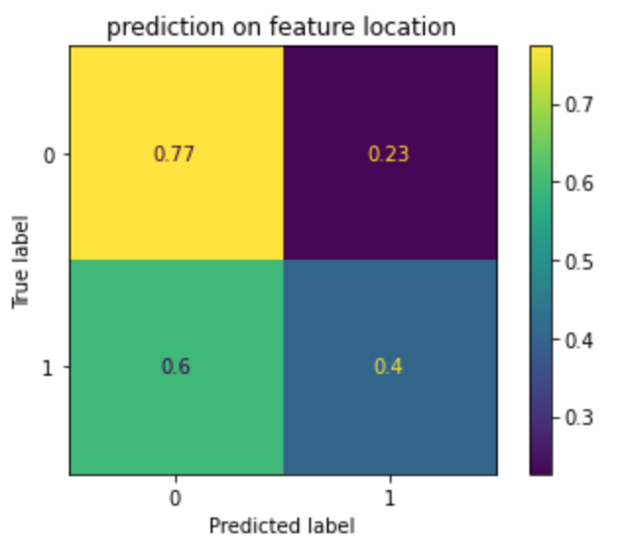
Prediction
Cross_val_Score von 0.5898960911623681
mit (tfidf_vectorizer_loc,LogisticRegression())
tfidf_vectorizer_loc = TfidfVectorizer(analyzer='word',
ngram_range=(1,1))

Slide 17
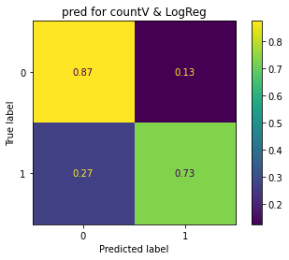
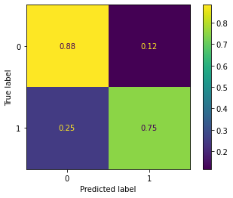
Progress
Day 1: Day 4: Day 5:
Tfidf + LogReg Classifier
stacking approach:
LogReg, KNN, Naive Bayes
Naive Bayes including Keywords and Text
Score Confusion Matrix
0.7898193760262726
0.8260013131976363
0.8128693368351937
highest score
lean model

Slide 18
Product
Warning App: https://x.thunkable.com/copy/57989626327f283cca1815d081083498

Slide 19
Backup

Slide 20
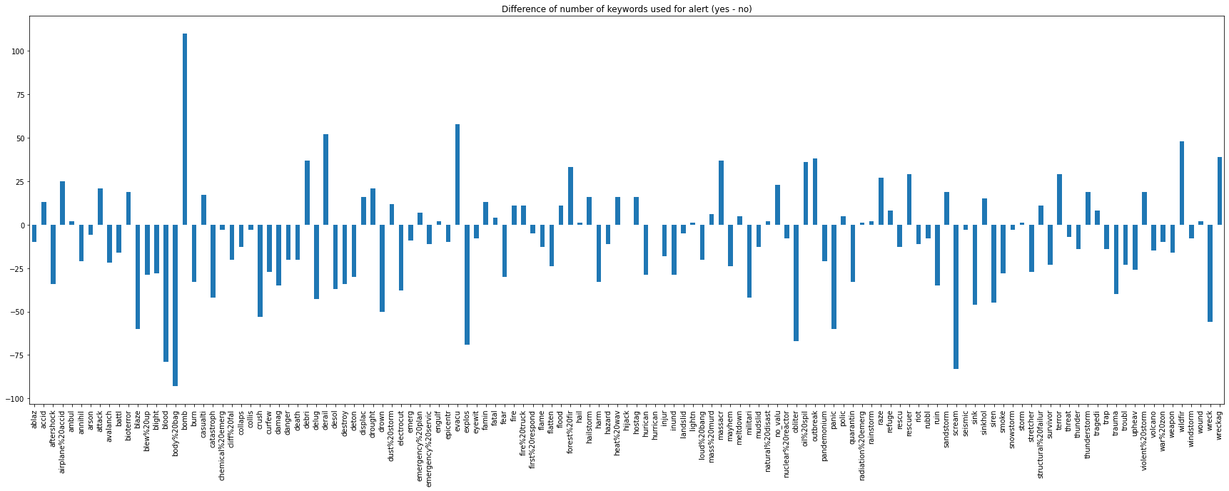
Useful graphs

Slide 21
Used techniques
Data wrangling
regex
replace by dict
POS / NER
ML
pipeline
Tfidf
CountVectorizer
XGBClassifier
stacking
App
thunkable

Slide 22
Workbench
# cleaning: df.replace("[^a-zA-Z' ]“).split().lower().re.findall().stopwords.

